Slide 1

University Shuttle Routing and Tracking Service
Final Year Project Presentation
18th April, 2019

Slide 2
UWI Shuttle Routing & Tracking System
Agenda
30 Seconds
Introduction
Introduction
1
Agenda and group members
1 Minute
The Problem
The Problem
2
The problem and our project idea

Slide 3
1 Minute
Main Beneficiaries
Main Beneficiaries
3
Target audience and users
1 Minute
Project Significance
Project Significance
4
Novelty of project
1 Minute
Goals and Objectives
Goals and Objectives
5
The goals and objectives of the project

Slide 4
1 Minute
Application Design
Application Design
6
Architecture and technologies used
1 Minute
Use Case 1: Students
Use Case 1: Students
7
Student finds information about shuttle
1 Minute
Use Case 2: Drivers
Use Case 2: Drivers
8
A driver arrives at work and goes on duty

Slide 5
1 Minute
Use Case 3: Admins
Use Case 3: Administrators
9
Administrator configures a new route
1 Minute
Testing
Testing
10
User testing of the application
30 Seconds
Future Works
Future Works
11
The future of UWI SRTS

Slide 6
Introduction
30 Seconds

Slide 7



Our Group Members
Final Year Project
CS
CS
CS
Azel Daniel
816002285
Michael Bristol
816003612
Amanda Seenath
816002935

Slide 8
The Problem
1 Minute

Slide 9
The Problem
The problem that our project addresses
The problems with the current shuttle service
Shuttles do not follow schedule
Shuttles do not arrive on time
Problems
Students left stranded
Students inconvenienced

Slide 10
The Project Idea
The basic solution that our project offers
Track real time location
of shuttles
1
3
Shows alerts about
shuttles
Estimated times of arrival
of shuttles
2
4
Show route information
to students and drivers

Slide 11
Main Beneficiaries
1 Minute

Slide 12






Main Beneficiaries
Target audience and users
UWI Students
Shuttle Drivers
Campus Security
Group Members
Lecturers
UWI Administrative
Staff

Slide 13
Project Significance
1 Minute

Slide 14
Project Significance
Novelty of project
Streamlines shuttle boarding process
Risk reduction
More efficient shuttle service
More students will use the service
Improves sense of security
More accountability by drivers
Improve driver-student relations
Reduce driver workload
There are currently no services in place which provides a solution to the problem.

Slide 15
Goals and Objectives
1 Minute

Slide 16
Goals and Objectives
What are the goals and objectives of the project?
1
2
3
Specify user requirements
Specify product design
Understand existing system
4
5
Develop the application
Application testing

Slide 17
System Design
1 Minute

Slide 18
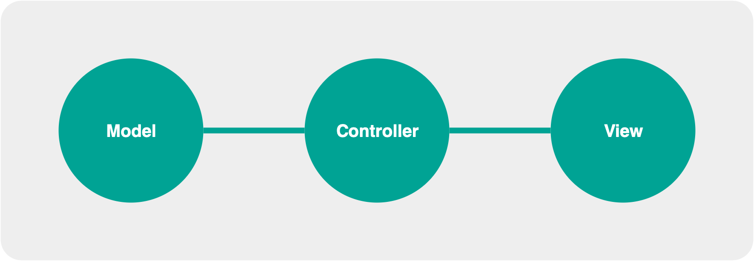
Application Architecture
The macro architecture of the application
Model View Controller architecture

Slide 19





Technologies Used
The main technologies used in the project
Firebase
Github
Google Maps
Android Studio
Google Forms

Slide 20

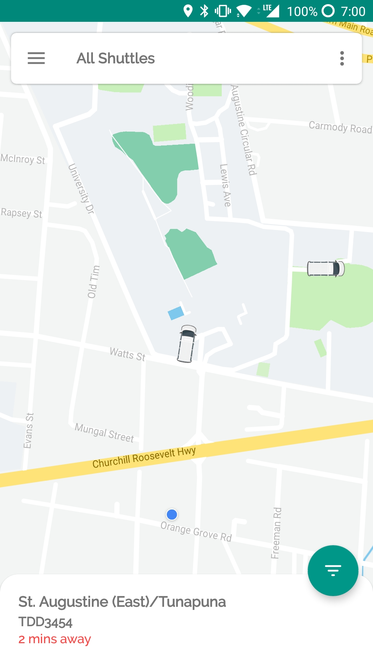

Behold! The UWI SRTS Application
Tracks shuttles’ real time location
Calculates shuttle eta to a users current location
Gives drivers directions while on duty
Allows admins to configure route information
Shows alerts related to the shuttle service

Slide 21
Use Case 1: Students
1 Minute

Slide 22

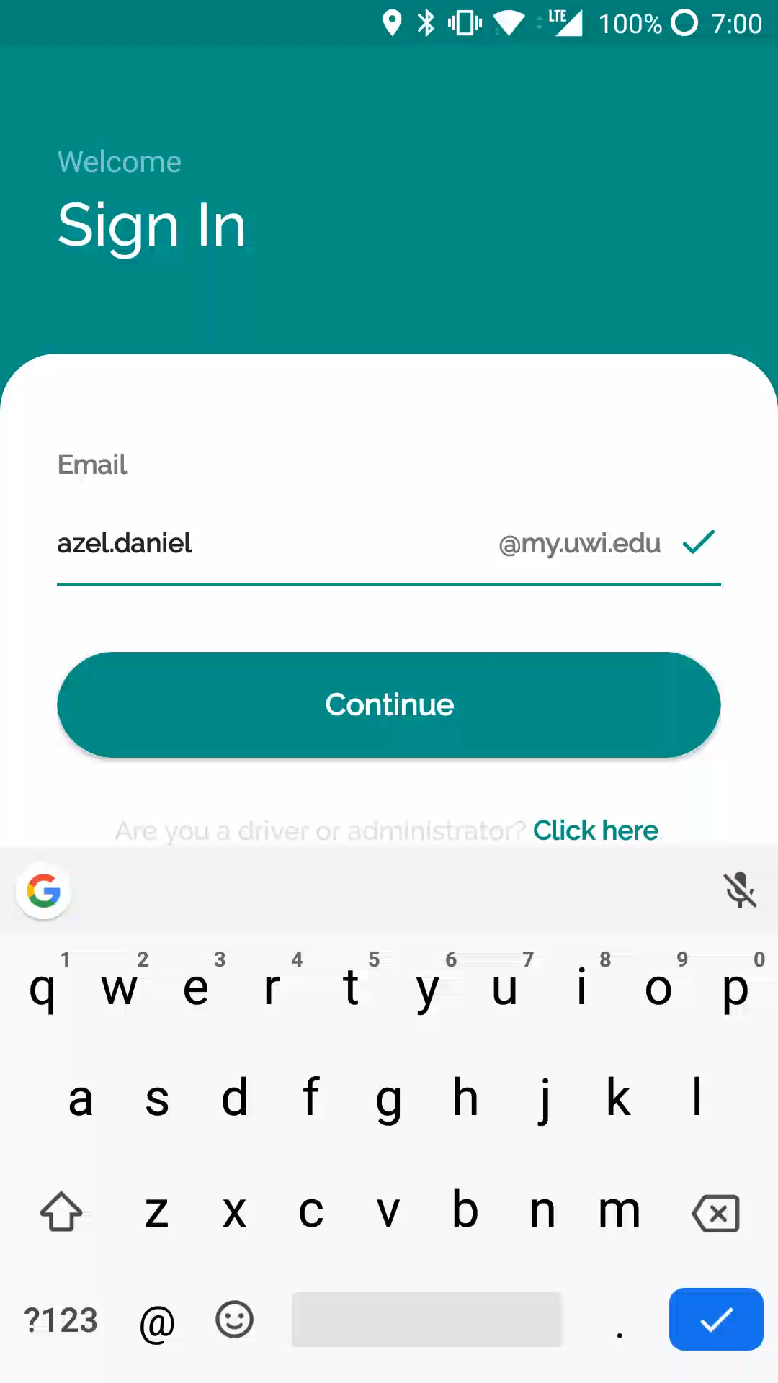
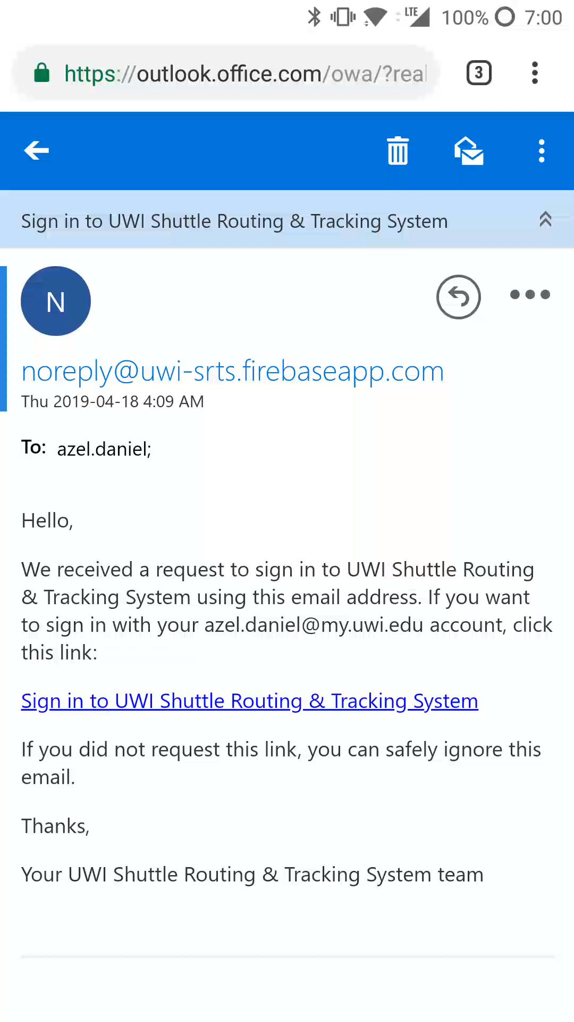
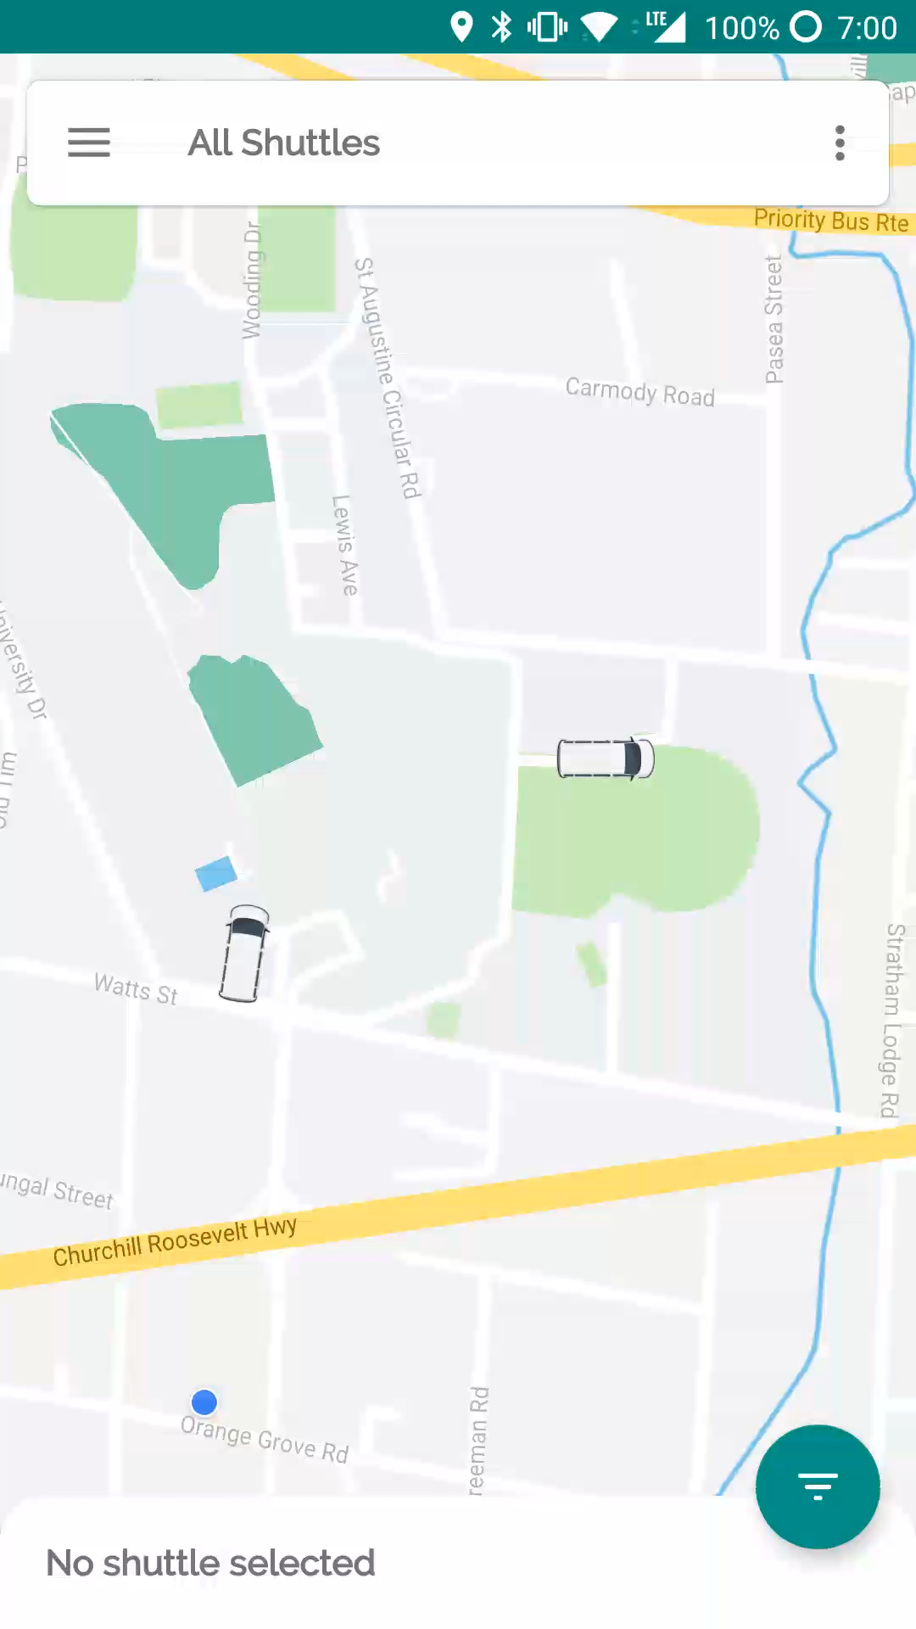
Use Case 1: Students
Student finds information about shuttle
Enter email
Click verification link
View shuttle

Slide 23
Use Case 2: Drivers
1 Minute

Slide 24

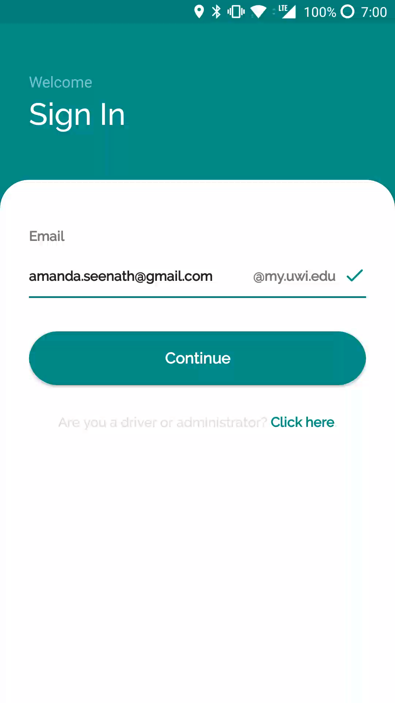
UWI SRTS
Use Case 2: Drivers
Login using email and password
Select shuttle
Select route
Select on duty status
View route information

Slide 25
Use Case 3: Administrators
1 Minute

Slide 26
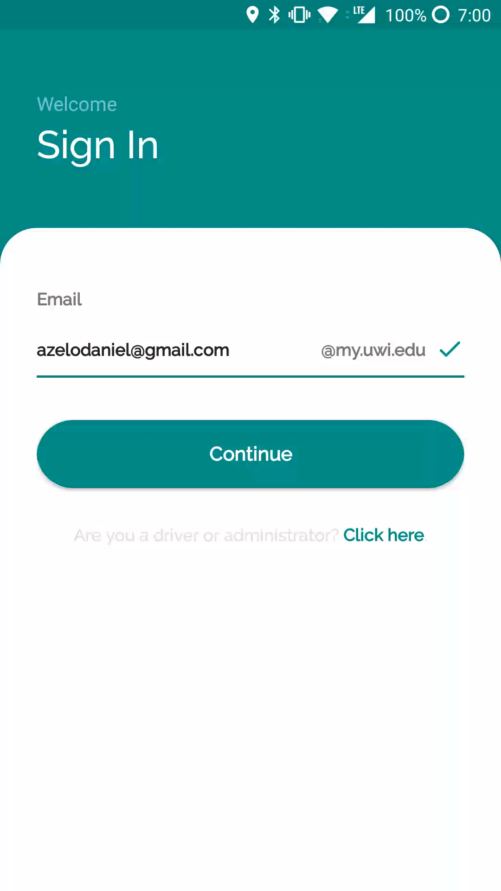
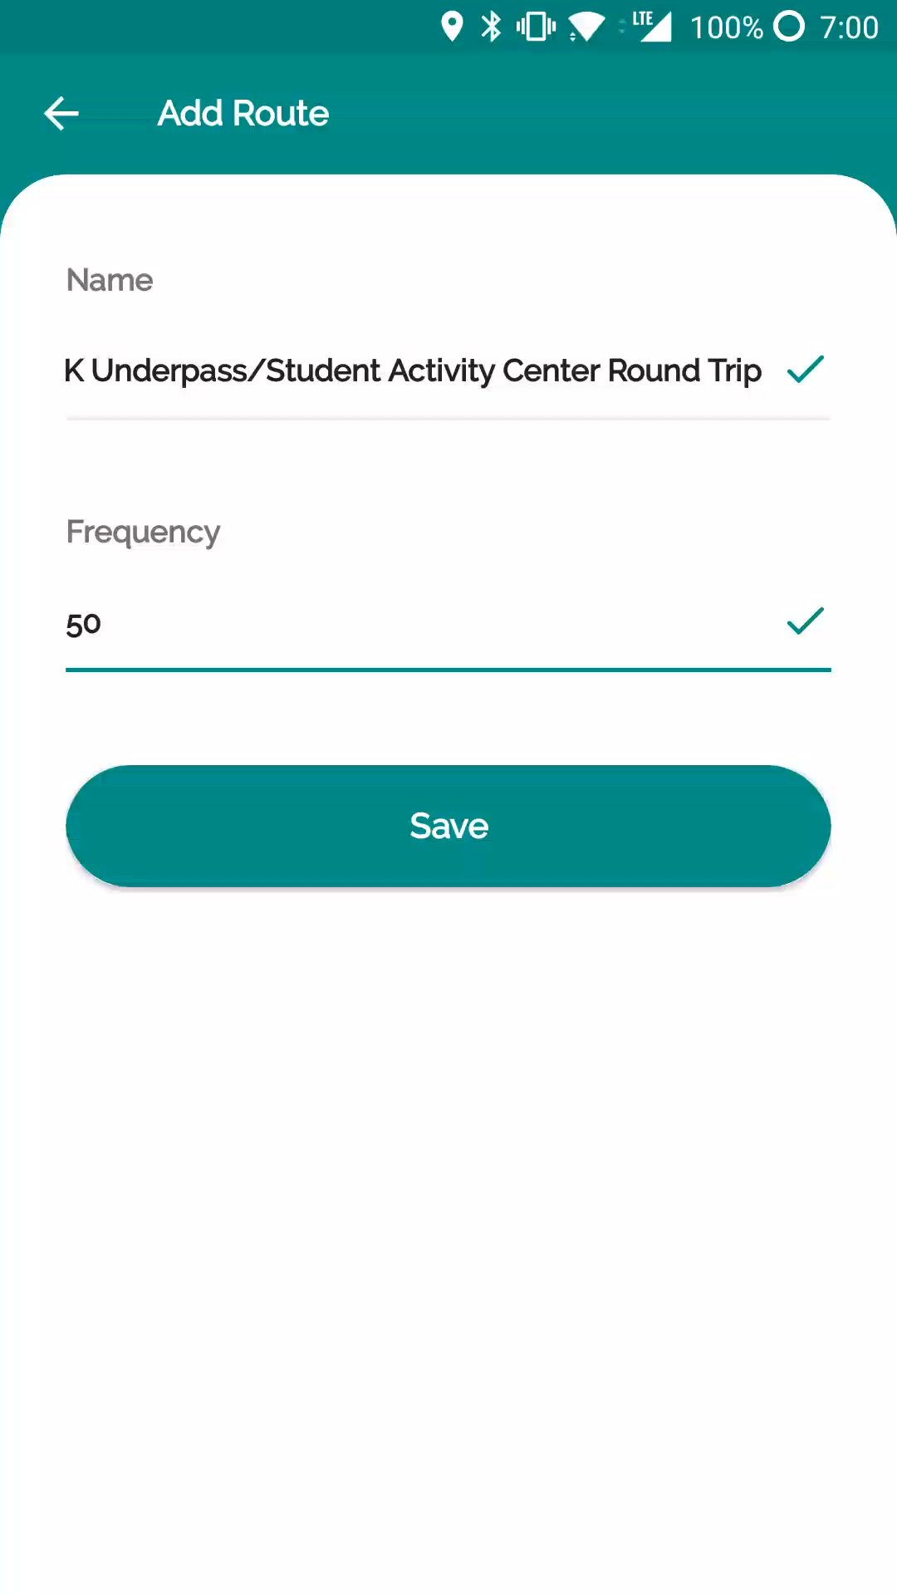
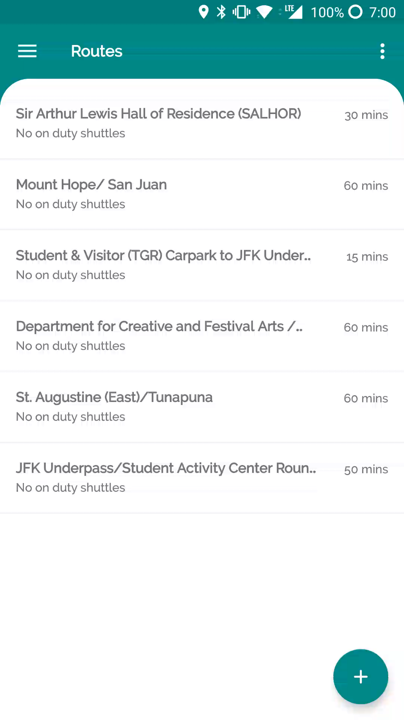
Use Case 3: Administrators
Administrator configures a new route
Sign in
Create route
Edit route to add stops

Slide 27
Testing
1 Minute

Slide 28
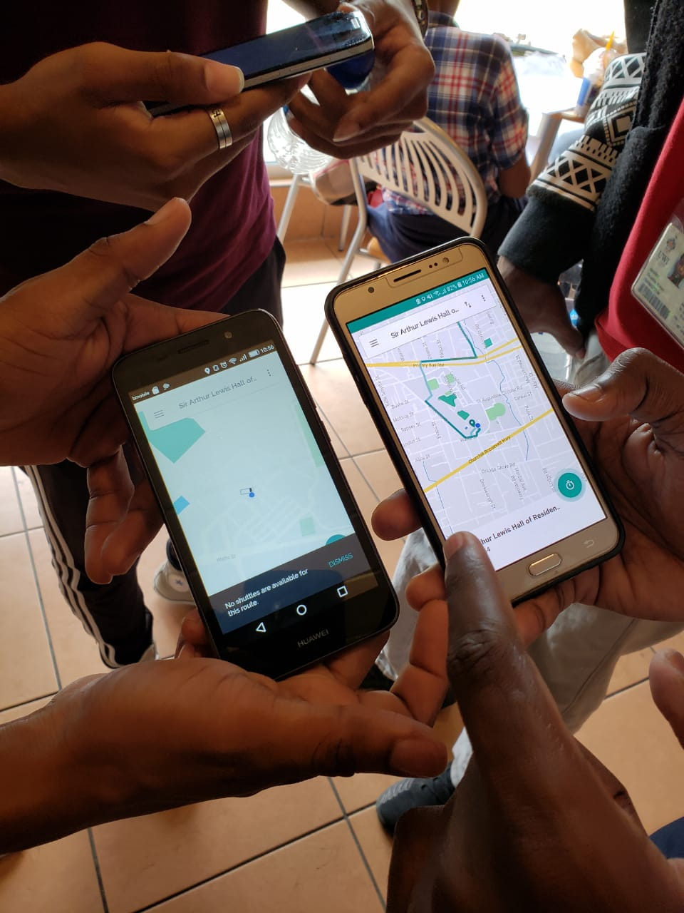
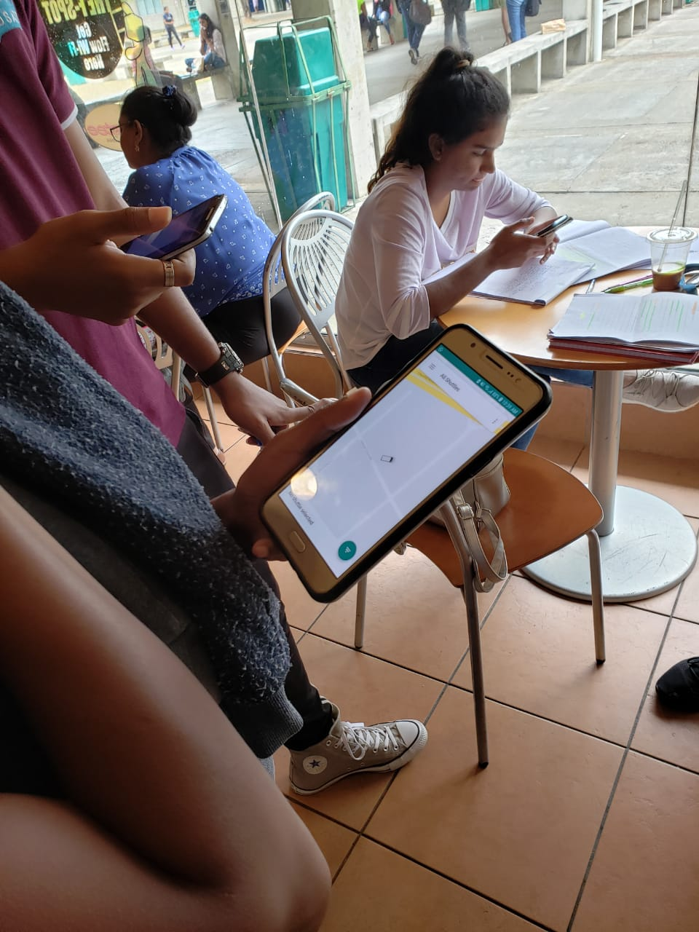
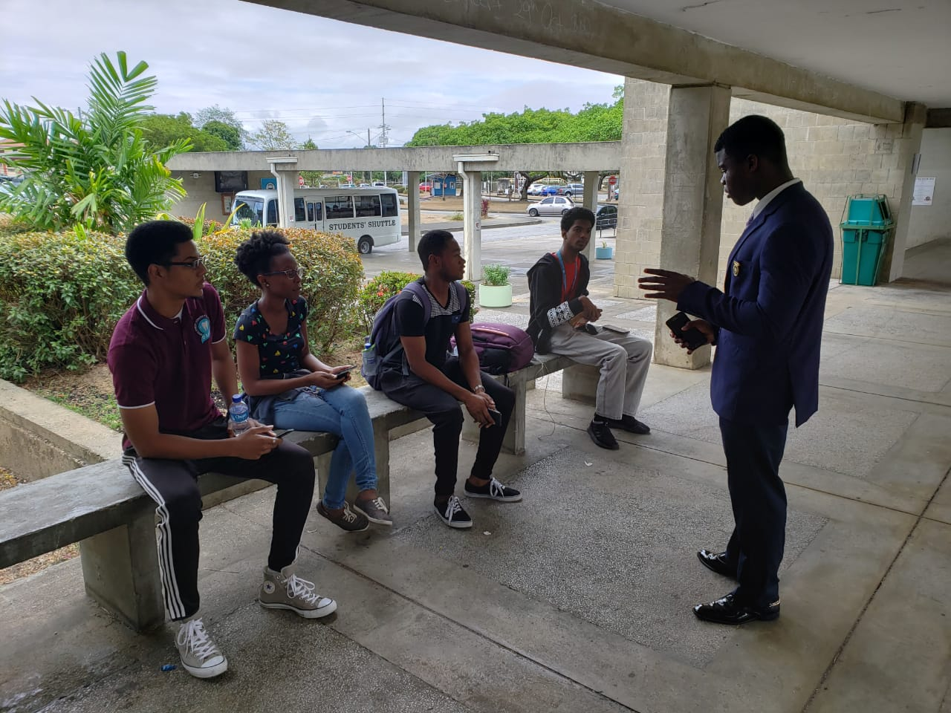
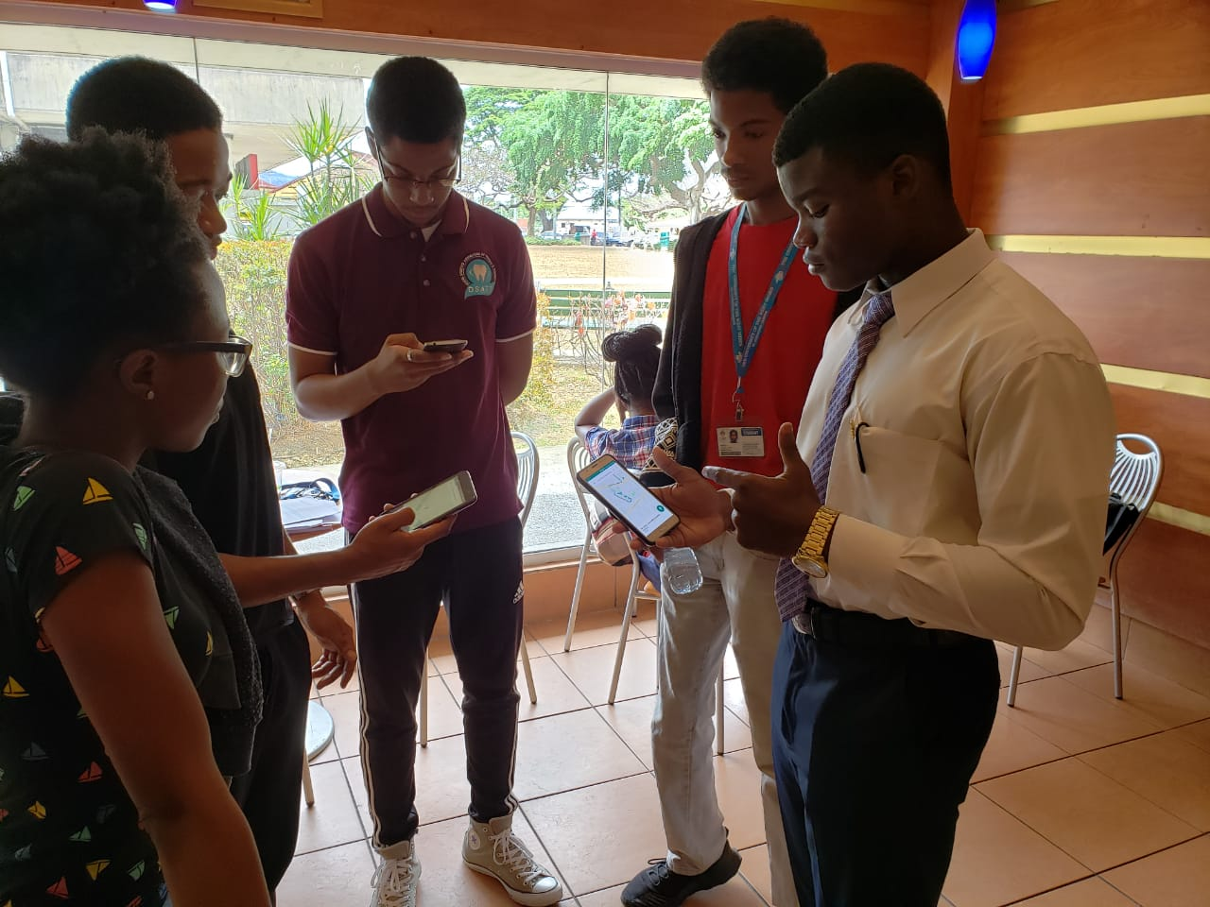
Iteration 1
User testing for iteration
1 of the project
This revealed many small bugs in the application

Slide 29
Future Works
30 Seconds

Slide 30



Future Works
The future of UWI SRTS
iOS Application
Native Notifications
for alerts
Reservation System

Slide 31
Thank You!
Questions?
https://uwi-srts.000webhostapp.com/

Slide 32
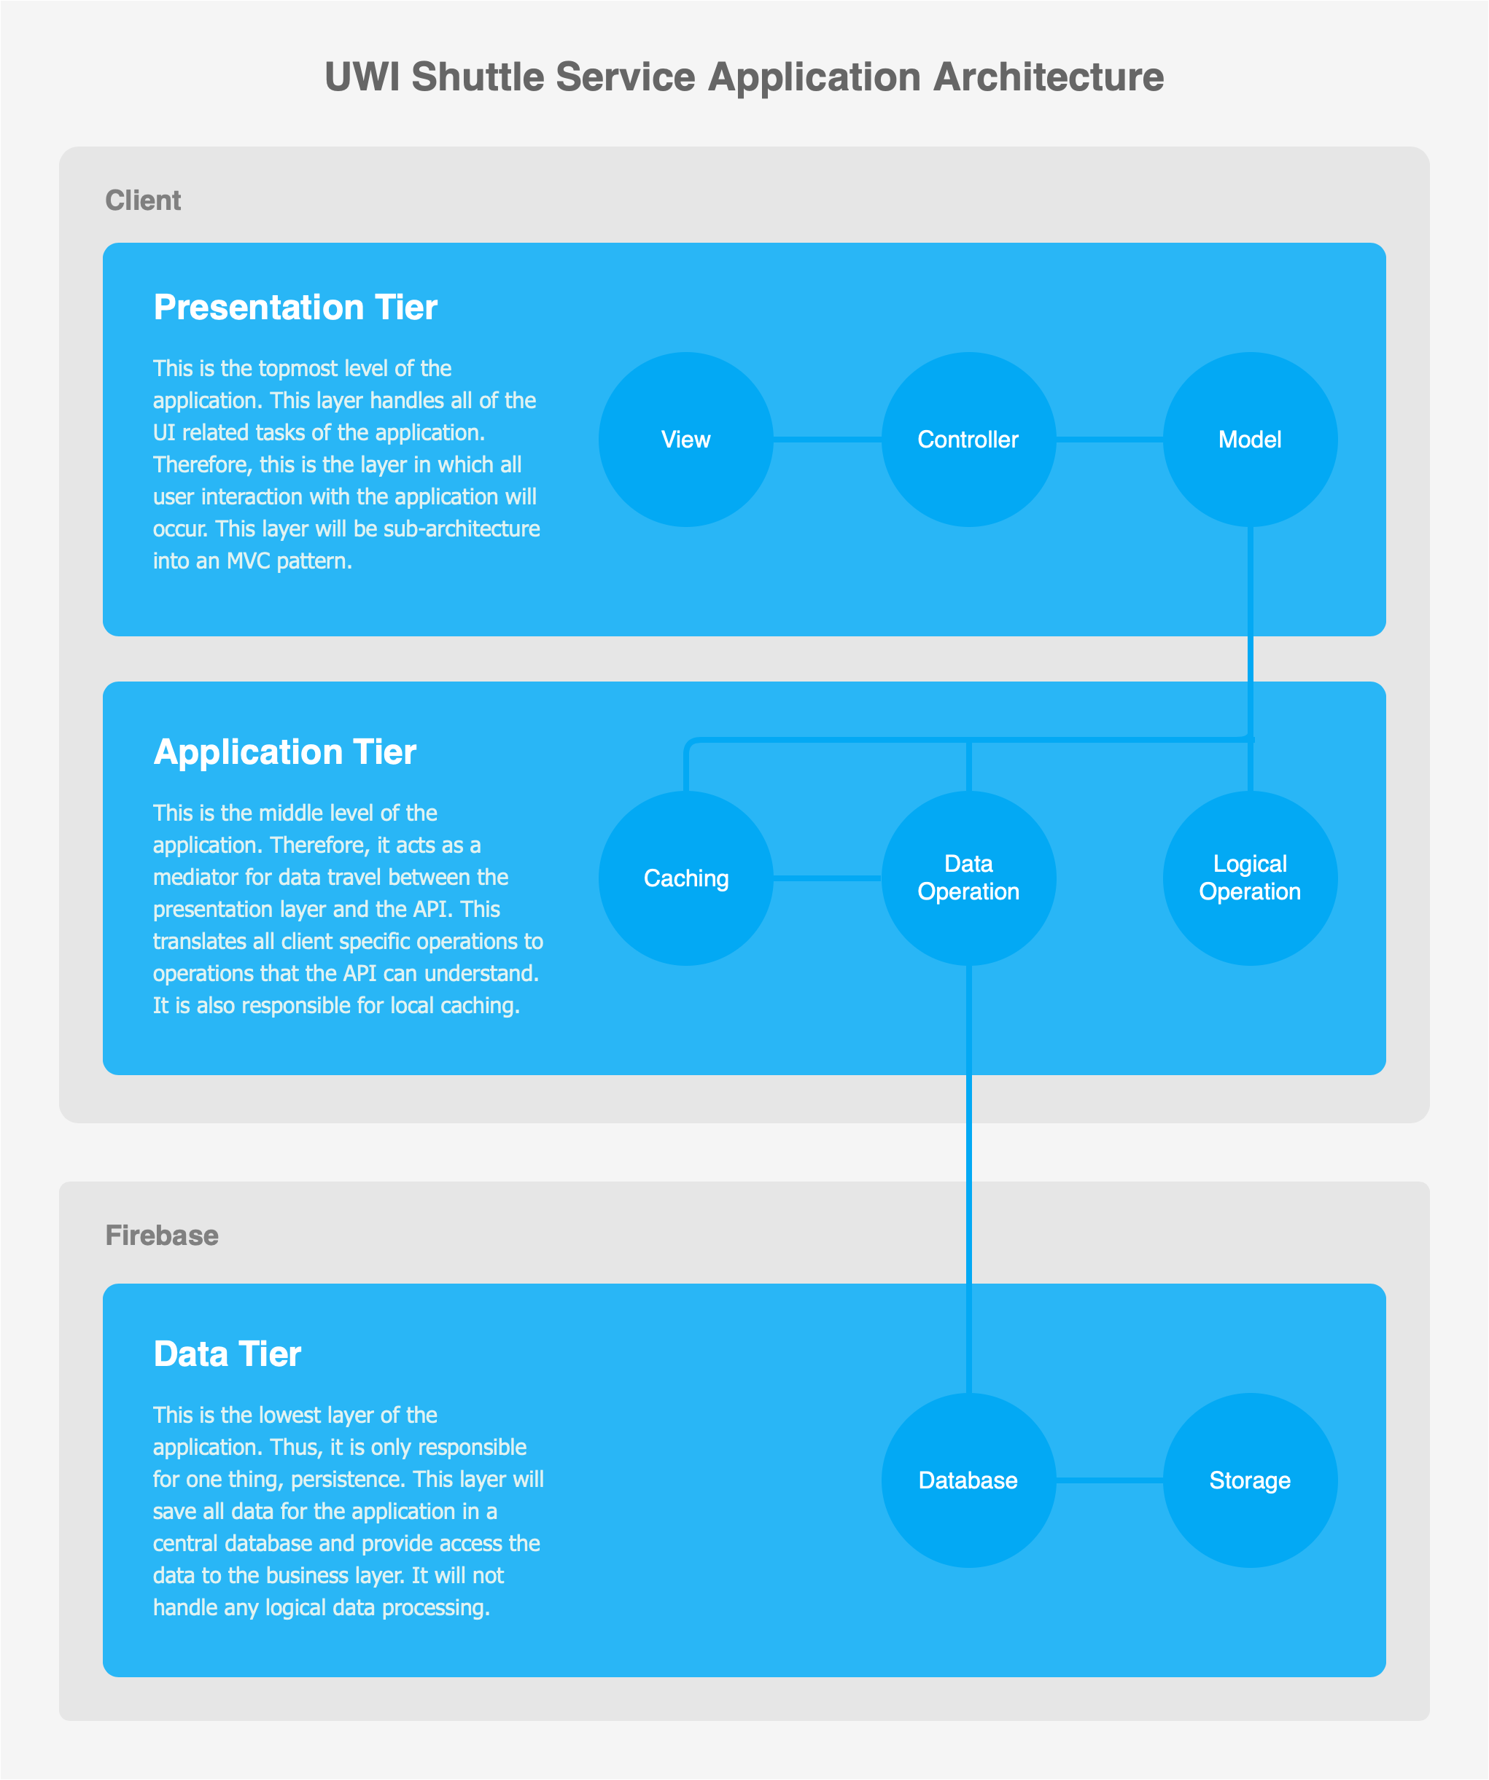
Appendix A
Architecture Diagram

Slide 33
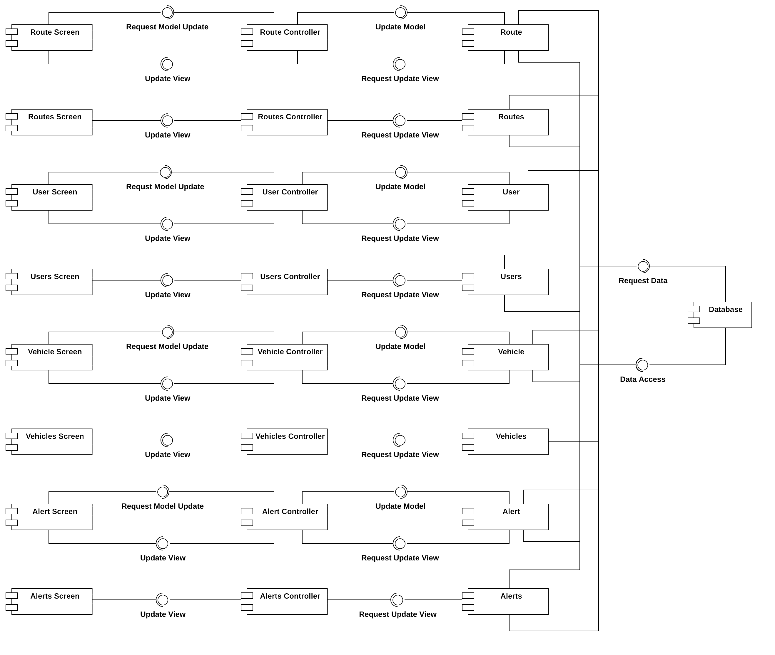
Appendix B
Component Diagram

